Slide 1


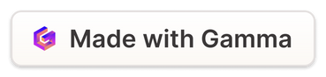
Drug Safety and Pharmacovigilance: Exploratory Analysis of Patient Health Indicators
Notes:
1

Slide 2
Introduction to Drug Safety and Pharmacovigilance
Drug Safety
Pharmacovigilance
Ensuring the safety of medications for patients is paramount.
This involves monitoring and assessing the safety of drugs throughout their life cycle.
Notes:
2

Slide 3
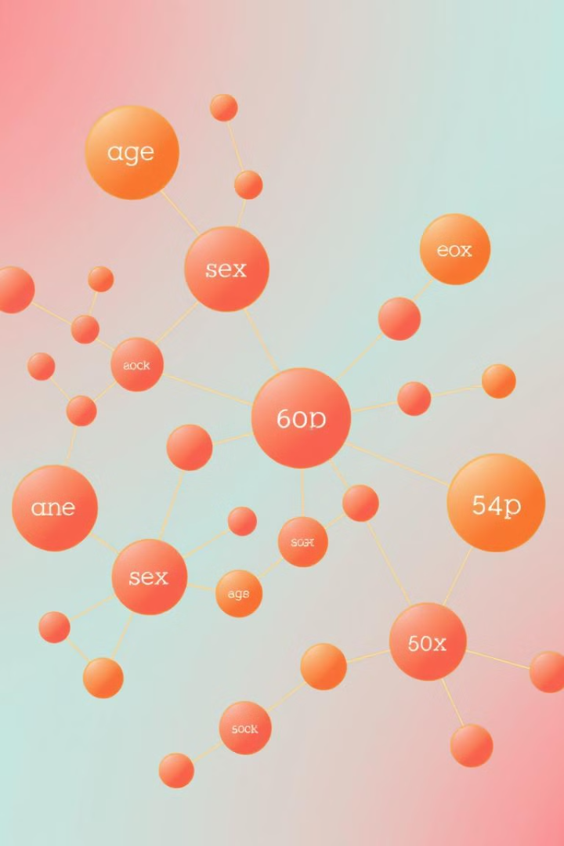
Objective and Scope of the Analysis
1
Understanding Patient Health Profiles
2
Identifying Potential Risks
Analyzing how patient health indicators influence drug safety.
Detecting patterns that may indicate adverse drug reactions.
3
Improving Drug Safety Monitoring
Developing insights to optimize pharmacovigilance practices.
Notes:
3

Slide 4
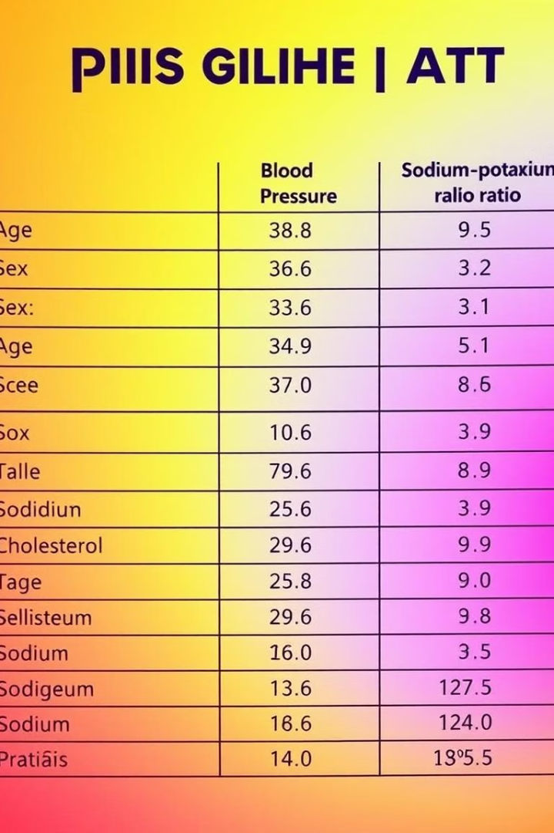
Data Overview: Age, Sex, Blood Pressure, Cholesterol, and Sodium-Potassium Ratio
Age
Sex
Blood Pressure
Cholesterol
Sodium-Potassium Ratio
45
Male
120/80
180 mg/dL
2.5
62
Female
130/90
220 mg/dL
3.0
Notes:
4

Slide 5




Exploratory Data Analysis: Visualizing Key Patient Health Indicators
Age Distribution
Sex Ratio
Blood Pressure vs. Cholesterol
Histograms show the frequency of age groups in our dataset.
Bar charts illustrate the proportion of male and female patients.
Scatter plots visualize the relationship between blood pressure and cholesterol levels.
Notes:
5

Slide 6




Identifying Trends and Patterns in Patient Health Profiles
Age and Blood Pressure
1
As age increases, blood pressure levels tend to rise.
2
Age and Cholesterol
A similar trend is observed with cholesterol levels and age.
3
Blood Pressure and Cholesterol
A moderate correlation exists between blood pressure and cholesterol.
4
Sodium-Potassium Ratio
This indicator may reveal individual vulnerabilities.
Notes:
6

Slide 7




Implications for Improved Drug Safety Monitoring
Targeted Monitoring
Prioritize patients with higher risk based on their health profile.
Personalized Safety Strategies
Adjust drug dosages or treatment plans based on patient characteristics.
Data-Driven Decision-Making
Utilize these insights to inform drug development and safety policies.
Notes:
7

Slide 8

Conclusion and Next Steps
1
2
Data-Driven Insights
Future Research
This analysis provides valuable information for drug safety monitoring.
Further explore the influence of other health indicators and drug interactions.
3
Continuous Improvement
Enhance pharmacovigilance practices to ensure patient safety.
Notes:
8

